Slide 1

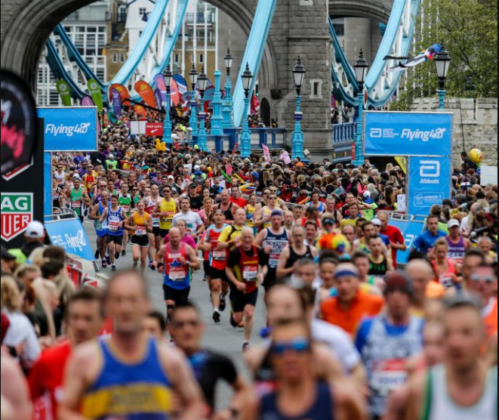
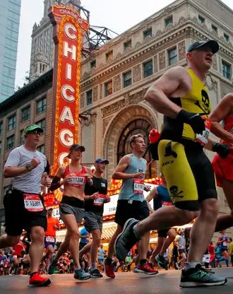

Marathon Runners
Brian, Sonal, Amit, and Olga

Slide 2
Why Marathon Data?
We like running, we are runners!
We are curious about trends in running
Running == FUN!!!!!!

Slide 3
Data used and sources
Lists of Marathon Winners since 1970 to 2019 for:
London, New York, and Chicago Marathons (Source: Wikipedia )
GDP per capita (Source: World Bank)
Country Obesity rate (Source: The World Factbook)

Slide 4
Interesting things we noticed:

Slide 5
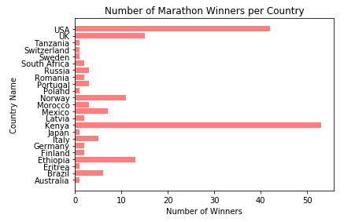
What country has the most wins since 1970?

Slide 6
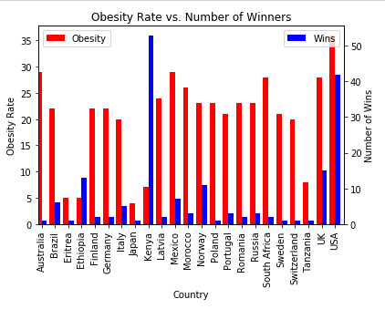
Obesity rates seemed promising at first…

Slide 7
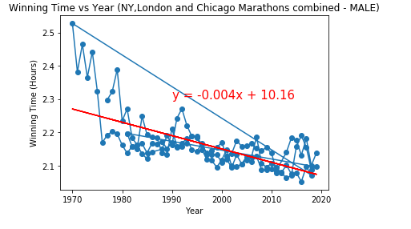
Male runners have become faster over time

Slide 8
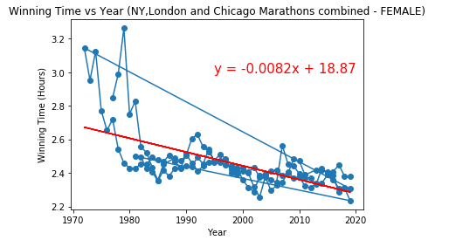
Female runners have become faster over time.

Slide 9
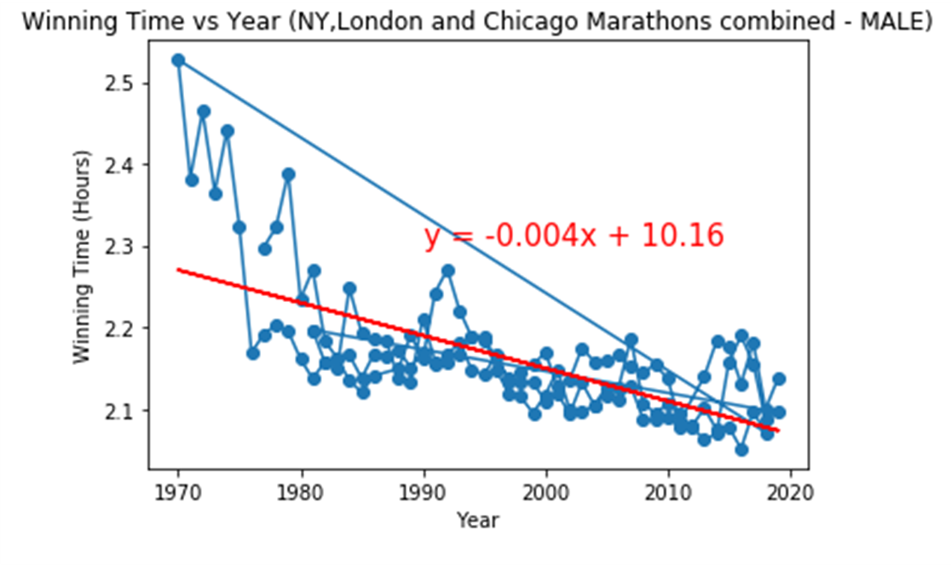
The data seems to indicate that Males runners have been able to run a marathon faster than Females runners since 1970.

Slide 10
GDP per capita has no effect in marathon winners over time
Null Hypothesis:

Slide 11
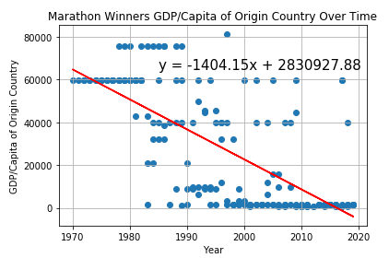
GDP …
P= 4.6165677252211675e-27

Slide 12
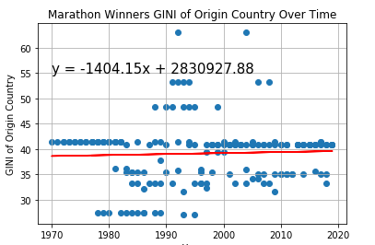
GINI …
P = 0.5542831615073762

Slide 13
Other factors we would have liked to explore:
Country’s diet
Generics
Runner’s heights
Add other events
Look at the countries that participated in the races
What’s Kenya’s secret?
Speed
Diet
Generics

Slide 14
Learnings:
Finding the datasets sooner would have been helpful
GitHub was a bit of challenge

Slide 15
Thank you! Any Questions?

